Slide 1
Introduction to Data Science Data Mining for Business Analytics
Brian d’Alessandro
VP – Data Science, Dstillery
Adjunct Professor, NYU
Fall 2014
Fine Print: these slides are, and always will be a work in progress. The material presented herein is original, inspired, or borrowed from others’ work. Where possible, attribution and acknowledgement will be made to content’s original source. Do not distribute, except for as needed as a pedagogical tool in the subject of Data Science.
Notes:
https://www.youtube.com/watch?v=aMDe5pODkB0 (harlan harris)

Slide 2
Ensemble methods
Notes:
The goal of finding structure is to information from one source to reduce uncertainty about another source.
What does this mean? Conditional distribution example. I.e., carnival guy who guesses your weight. If I can see your height I can reduce uncertainty about weight.
Find some height/weight data.
Under supervised exploration:
How can we (automatically) obtain a selection of the more informative variables with respect to predicting the value of the target variable?
Even better, can we obtain the ranking of the variables?
Can think of importance as one that makes the target variable more pure. This leads to the notion of entropy.

Slide 3

Wisdom of crowds
This concept can be applied to Machine Learning. This is called Ensemble Learning
Conditions for This to Work
Diversity
Each person should have private information
Independence
Peoples opinions aren’t determined by opinions of others
Aggregation
Some mechanism exists for turning individual opinions into a collective decision.

Slide 4

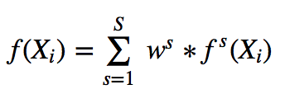


a simple ensemble method
Stacking – Let f^{s}(X_{i}) be some prediction on a sample using some arbitrary classifier s. Stacking is the process of taking a weighted combination of the predictions of a total of S different classifiers.
The weights can be a simple average, or learned via a secondary classification/regression process.

Slide 5
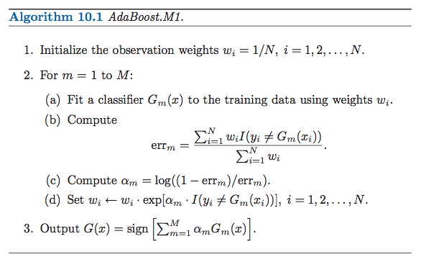
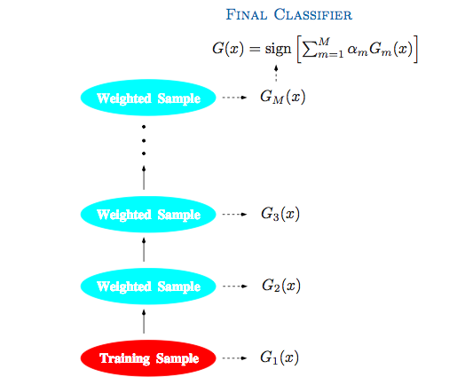
Popular ensemble methods
Boosting– A process for combining many weak learners into a powerful strong learner. The two most popular methods are AdaBoost and Gradient Boosted Trees. These are two of the most powerful and popular out-of-the box ensemble methods.
Intuition: use observed classification errors to reweight examples. At each iteration, incorrectly classified examples are upweighted so the model focus more on the hard to predict examples.
Image source: ESL2

Slide 6
Bagging
Notes:
The goal of finding structure is to information from one source to reduce uncertainty about another source.
What does this mean? Conditional distribution example. I.e., carnival guy who guesses your weight. If I can see your height I can reduce uncertainty about weight.
Find some height/weight data.
Under supervised exploration:
How can we (automatically) obtain a selection of the more informative variables with respect to predicting the value of the target variable?
Even better, can we obtain the ranking of the variables?
Can think of importance as one that makes the target variable more pure. This leads to the notion of entropy.

Slide 7
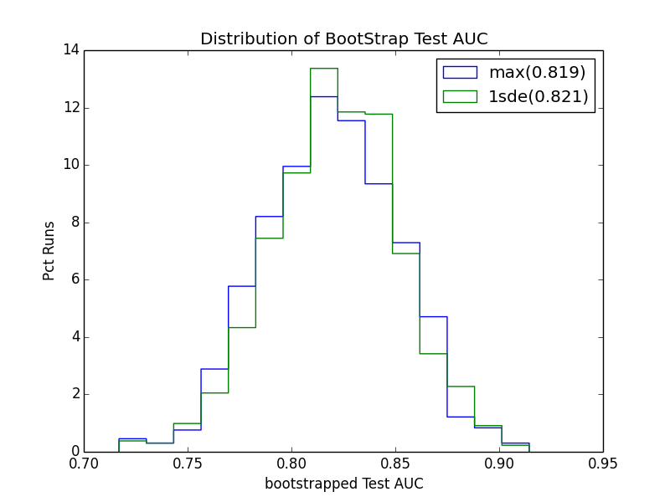
Remember bootstrapping
Previously we used the bootstrapping procedure to learn empirical estimates of our out-of-sample error variance. Put another way, it helps us understand the variance of our predictions.

Slide 8
Bootstrap aggregating
We can also use bootstrapping to improve the underlying predictions.
This is done via a procedure called Bootstrap Aggregating, or BAGGING.
The Bagging Procedure:
Create a bootstrap sample of the data
Fit the model on the bootstrap sample from step 1
Make prediction on train/test data using model from step 2
Repeat this N times, storing each prediction of step 3
Make a final prediction by averaging the bootstrapped predictions

Slide 9
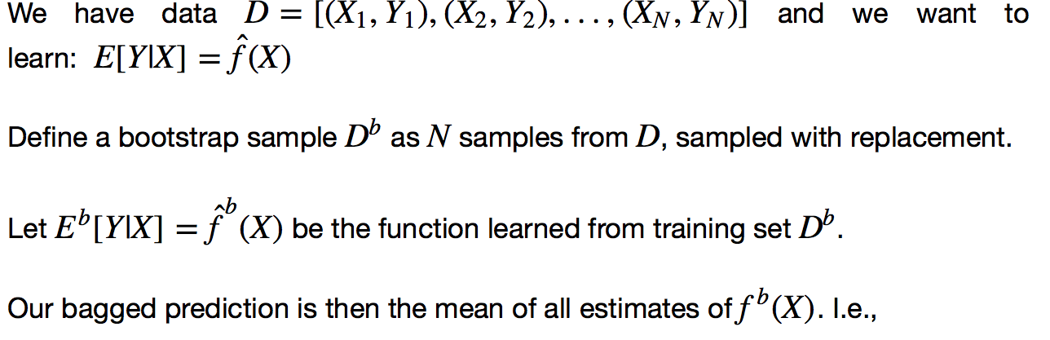
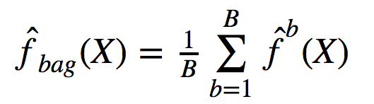
Bagging (formalized)
The Bagging Procedure:

Slide 10
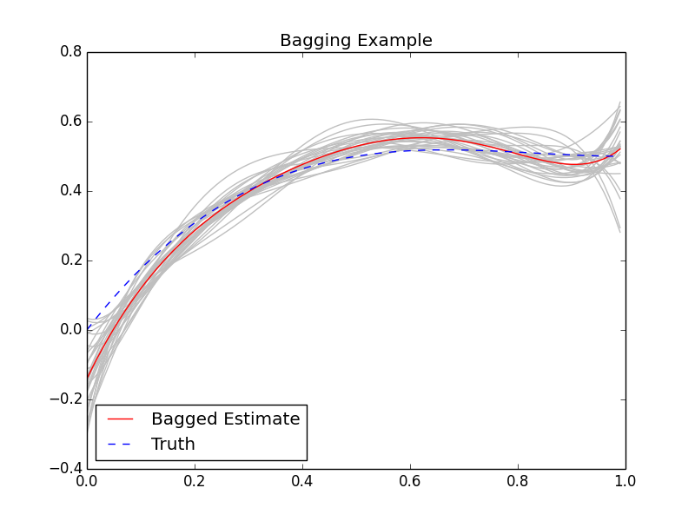
Example bagging
Each grey line is an individual bootstrap prediction. The red line is the average of all of the bootstrap predictions. The blue line is the truth (known via simulation). Each single estimate is very high variance (especially in the tails), but bagging reduces the variance and results in a better prediction.

Slide 11
When to use bagging
According to the seminal paper on bagging by Leo Breiman, Bagging:
“can push a good but unstable procedure a significant step towards optimality”
“can slightly degrade the performance of stable procedures”
Q: What is an unstable procedure?
A: One in which small permutations of the training data result in dramatically different models

Slide 12
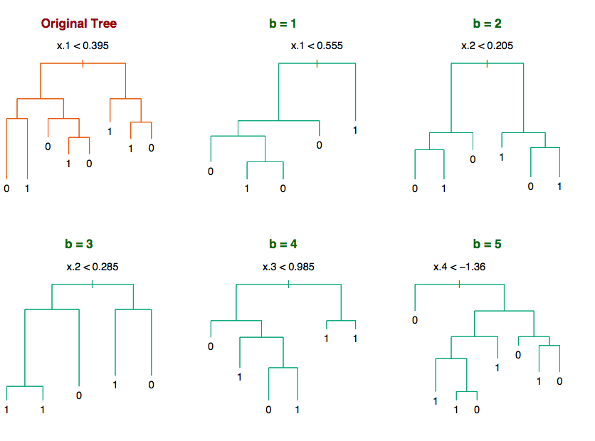
example unstable algorithm
From ESL2: “…a decision tree on simulated data. Small variations of the data (generated by bootstrap sampling) produce wide variations in the learned tree.”
Source: ESL2

Slide 13
Wisdom of a crowd of Treess
Each bootstrap sample can be thought of as an independent “expert” making a vote. However, we know the bootstrapped trees are not independent because each sample shares samples as well as features.
Source: ESL2

Slide 14
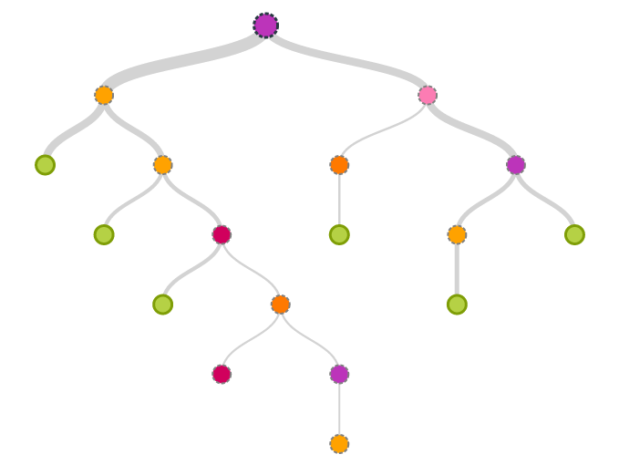
Decorrelating trees
Trees built on all features have high correlation, but we can mitigate this by randomly selecting subsets for any given tree. A good rule of thumb is |Subset| = SQRT(Total Features)
X₁
X₂
X₃
X₄
X₅
X₆
X₇
X₈
X₉
X₁
X₄
X₆
X₄
X₈
X₃

Slide 15
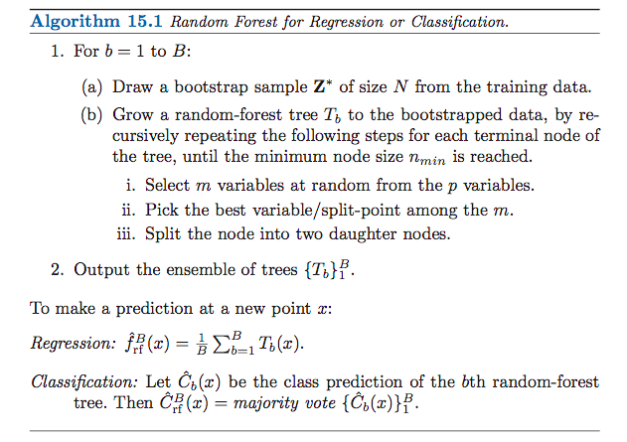
The rf algorithm
The RF procedure is straightforward and easily parallelized.
Source: ESL2

Slide 16
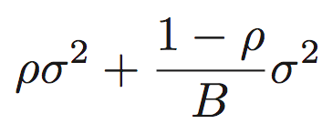
Why it works
Bias
A decision tree is unstable, and has high variance, but can also have extremely low bias
Can detect all manner of interaction effects
Especially when allowed to grow very deep
The bias of the average of identically distributed trees is equal to the bias of the individual trees (in this case, very low).
Variance
If the variance of an individual tree is σ² and the pairwise correlation of any two trees is ρ, then the variance of the forest is:
Randomly sampling features reduces the pairwise correlations ρ and reduces the 1st term above, while bootstrapping reduces the 2nd term above. Note though, that reducing the features decreases total variance but also increases the bias.
Source: ESL2

Slide 17
Implementing in python
from sklearn.ensemble import RandomForestClassifier
rf = RandomForestClassifier()
rf = rf.fit(X, Y)
rf_pred = rf.predict_proba(X_t)

Slide 18
tuning
RF’s are quick to set up and might do fairly well straight out of the box. But nonetheless, tuning is always recommended.
Forest Level Parameters
# trees (n_estimators) – increasing this decreases variance, but increases training time.
# of features to sample (max_features) – the number of features sampled in each tree. Reducing this # increases the bias but decreases the RF variance.
Tree Level Parameters
# intermediate nodes (max_depth) – the size of the tree. Usually you don’t want to limit this (i.e., set max_depth=None)
Size of intermediate notes (min_sample_split) – the number of instances in an intermediate node, before splitting (usually good to set to 1).
We usually want to over-fit the individual trees, and as always, use some hold-out method to optimize Forest level parameters.

Slide 19
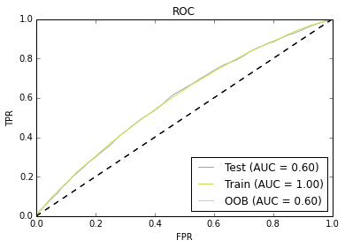
Out-of-bag error
Tuning via cross-validation can be very slow due to the number of trees that have to be built. Random Forests have a built in validation property called “out-of-bag” error estimation that can help us avoid x-validation. For each record, average f(x_{i}, y_{i}) on all bootstrap iterations in which record i was not sampled. This out-of-bag prediction can then be used for out-of-sample error estimation.
Observations:
Training AUC is 1!
OOB AUC is almost = Holdout AUC
Results of random forest run on Churn data from HW 3.
Notes:
Compare out-of-bag error to the xvalidation results.

Slide 20
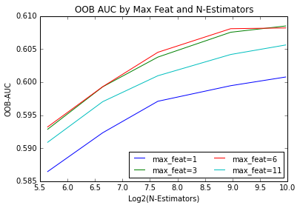
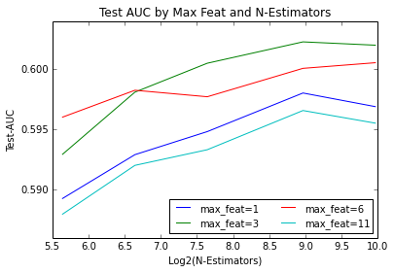
Example tuning
Here we use OOB AUC to find the right level for max_features and n_estimators.
Ideally we want the decision we make based on OOB AUC to be optimal when we reveal the ground truth on the test set.

Slide 21
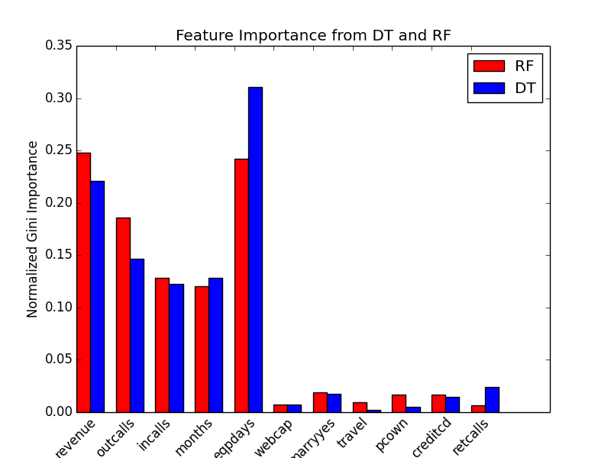
Feature importance
Much like with Decision Trees, the Random Forest Classifier has a built in mechanism for evaluating feature importance.
We see similar rankings in RF as DT, but RF is likely to be more robust, as it averages over many different trees.

